Slide 1
NEO4J CYPHER TUTORIAL WITH PYTHON
Load Json Data From Url Using Cypher ,Apoc & Python
Tutorial 89

Slide 2
Sample url
http://dummy.restapiexample.com/api/v1/employees

Slide 3
Use case
How To Json Data From Url Using Cypher ,apoc procedure & python

Slide 4
Pre-requisites
apoc.import.file.enabled=true
apoc.import.file.use_neo4j_config=false

Slide 5
Load json data from url using apoc procedures
call apoc.load.json("http://dummy.restapiexample.com/api/v1/employees")
yield value
return value.data
Code written in neo4j browser

Slide 6
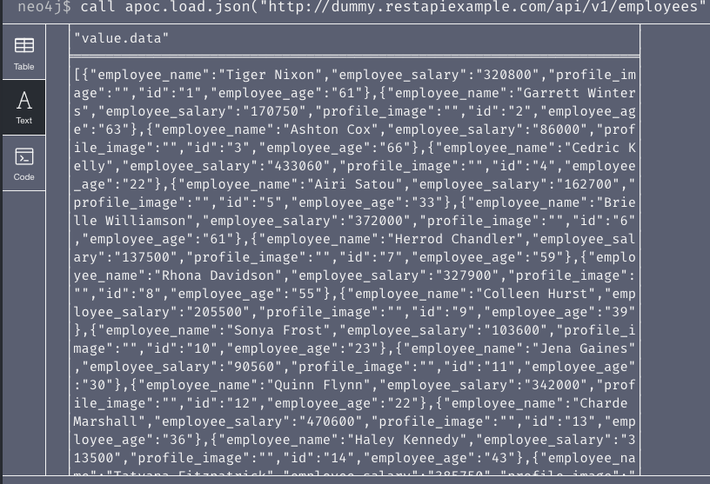
output
From neo4j browser

Slide 7
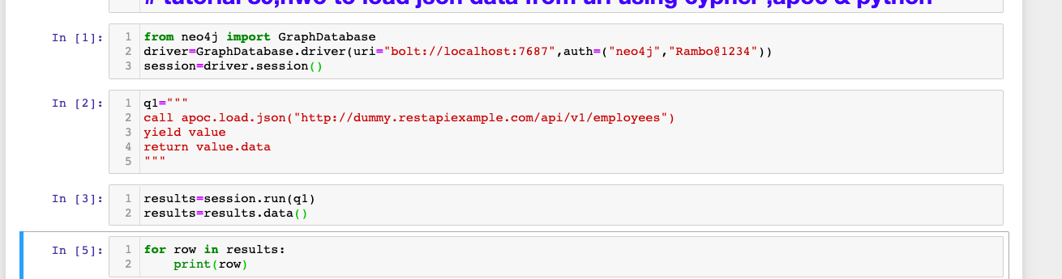
Load json data from url using apoc procedures
Code written in python ide

Slide 8
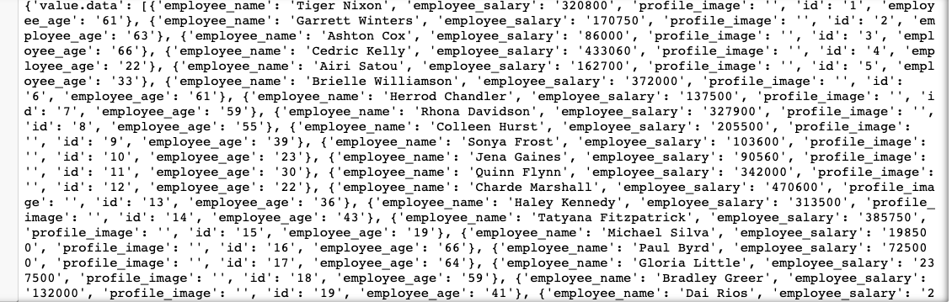
output
From python ide

